Slide 1
Surface Defect Detection and localization
Using Deep learning (in hot-rolled steel strips)

Slide 2
Introduction
Hot rolled steel is used in mining, agriculture, and building infrastructure and bridges, as it is economical, durable, and ductile.
Defect-free product needs to be used, but during different mechanical operations different types of surface defects shows up on the surfaces of hot-rolled strips, and lead to financial losses.

Slide 3
Need for automation
The traditional steel surface defect detection is completed by manual visual inspection combined with traditional machine vision.
Shortcomings in manual testing - external environment somewhat alters, such as an increase in noise or a change in lighting intensity and has low confidence and high labor intensity.
The traditional target detection selects candidate regions on a given image; then, the features are extracted manually and the trained classifier is used for classification. This method has high time complexity and low precision and is difficult to meet the actual production needs of the steel industry.

Slide 4
Objective
Automate repetitive processes to improve productivity and efficiency by automating the quality control process in industries.
To design a Deep learning model for classifying the images into different classes of defects
To design a model which can identify defect locations on the steel surfaces

Slide 5
What is Rolling
Rolling is a metal forming process in which metal stock is passed through one or more pairs of rolls to reduce the thickness, to make the thickness uniform, and/or to impart a desired mechanical property.
Two types of rolling processes -
Hot rolling
Cold rolling

Slide 6
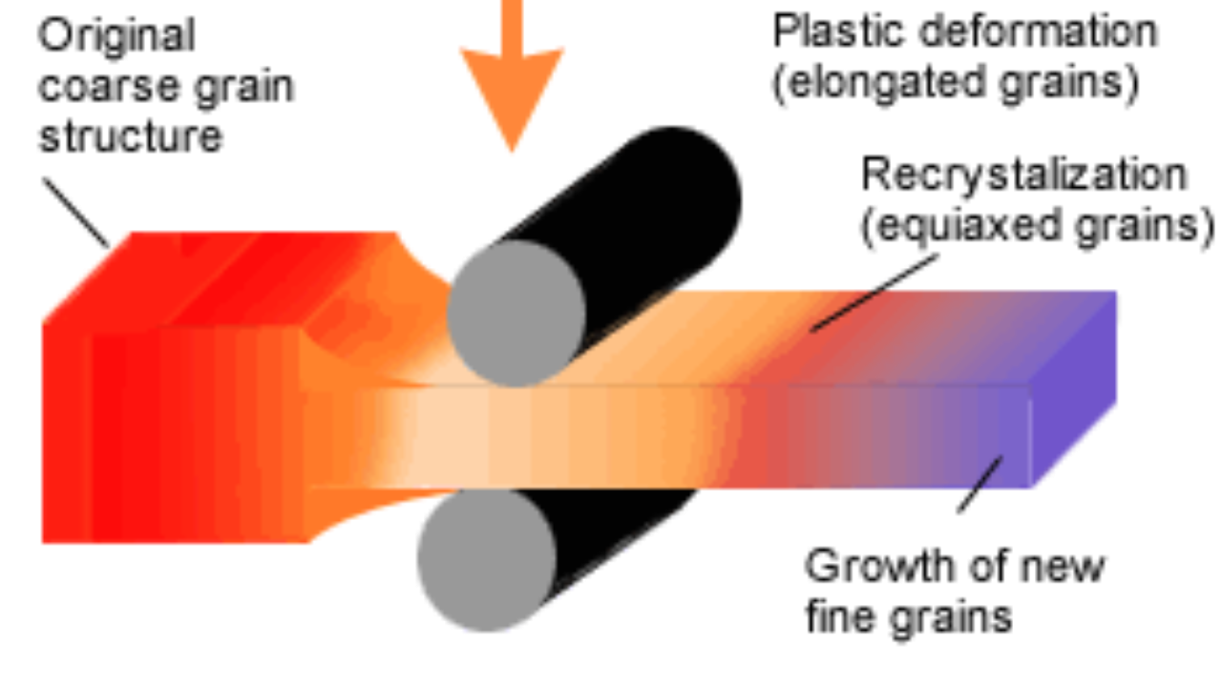
What is hot rolling?
Hot rolling is a metalworking process that occurs above the recrystallization temperature of the material. After the grains deform during processing, they recrystallize, the steel's microstructure undergoes permanent changes, resulting in enhanced toughness and ductility.

Slide 7
Advantages -
Disadvantages -
Brittle materials can be worked upon in hot rolling
Less force is required for deformation
Completely new grain structure formed, free of any mechanical stress.
Enhanced mechanical properties obtained, like increased toughness and ductility
Less dimensionally accurate, as edges deform and size reduces
Scaling of surface occurs due to high temperature
Decarburization of steel surface occurs
Materials are not easy to handle while performing hot rolling
Oxide formation on surface occurs

Slide 8
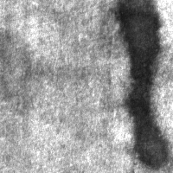
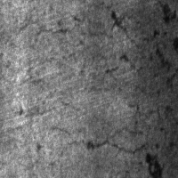
Surface defects in hot-rolled steels
Patches - Material discontinuities on steel surface
Crazing - Development of cracks on the surface of steel when it undergoes high stress

Slide 9
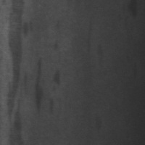
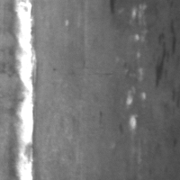
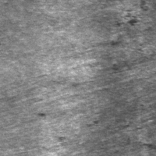
3. Inclusion - When some non-metallic inclusions are rolled into the steel surface.
4. Scratches - Due to accidental contact with the build-up of mechanical parts and mill components.
5. Rolled-in scale - Occurs when mill-scale is rolled into the metal during rolling process
Inclusion on surface
Rolled-in scale
Scratches on steel surface

Slide 10
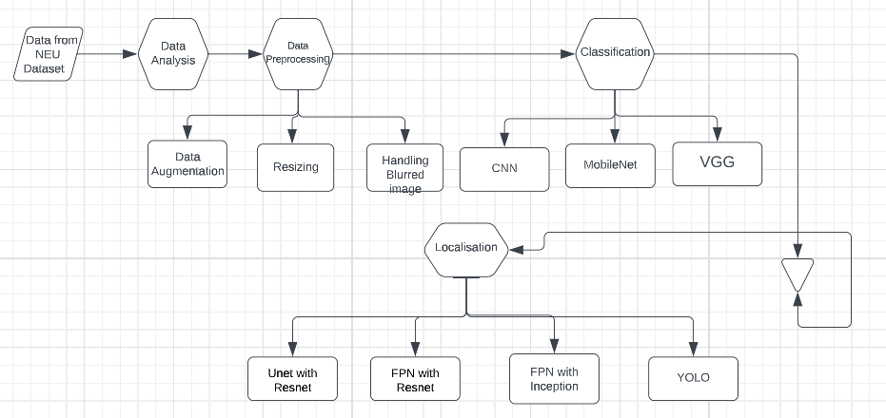
Flowchart

Slide 11
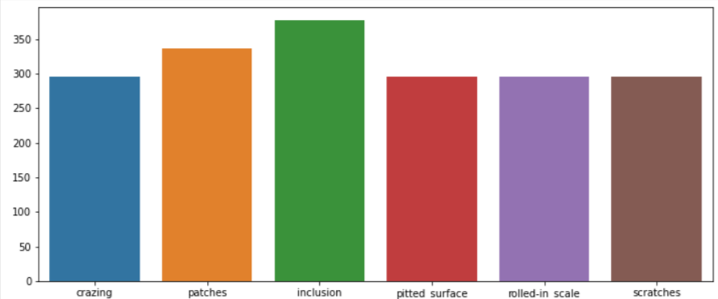
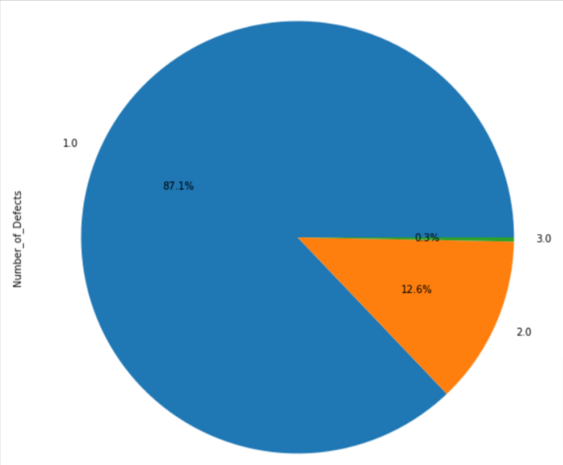
Data analysis
Majority of the images have a single type of defect but some have 2 types of defects and even some have 3 types of defects. But, samples with 3 types of defects are very less i.e only 0.3%.

Slide 12
Data preprocessing
Data cleaning and preparation are necessary in order to make the data appropriate for a machine learning model, which also improves the model's efficacy and accuracy.
Data Augmentation: We use 5 data augmentation techniques on training images so that our model becomes more generalized. These techniques include inverting, rotating, Flipping, adding contrast, and changing the saturation of the image dataset.
Dealing with Blurred images: We have used image sharpening and a blur filter. Also, we have found that if we add blurred image to the dataset the model efficiency for handling blurred images increases and hence it improves the accuracy of the model.

Slide 13
Classification problem
The data we are using is unstructured data in the form of images and there is one XML file corresponding to each image which contains the location of the defect. It is taken from Northeastern University (NEU) surface defect database. It includes six kinds of typical surface defects of the hot-rolled steel strip collected, i.e.
1. crazing (Cr)
2. patches (Pa)
3. pitted surface (PS)
4. rolled-in scale (RS)
5. inclusion (In)
6. scratches (Sc).

Slide 14
Convolutional Neural Network
CNN consist of two parts
Feature Extraction
Classification
Operations applied in feature extraction:
Convolution operation or Filter operation
Relu operation
Max pool operation
https://www.analyticsvidhya.com/blog/2021/05/convolutional-neural-networks-cnn/

Slide 15
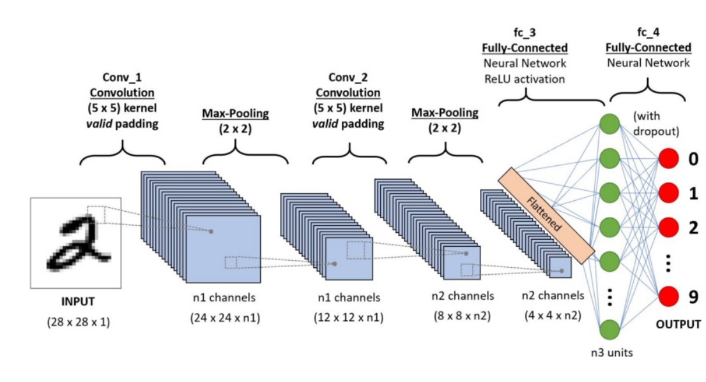
CNN
https://www.analyticsvidhya.com/blog/2021/05/convolutional-neural-networks-cnn/

Slide 16
Transfer learning
We have a Pre-trained model and then we try to retrain it for a new problem
Using transfer learning we can reduce the no. of epochs. It saves lot of computation.
Weights of the Hidden layers in the middle merely changes , so we get weights of a pre trained model and we change only last few layers for our new problem.
We have tried multiple models using transfer learning techniques for finding the best accuracy. These models are VGG16 and MobileNet.
https://www.youtube.com/watch?v=LsdxvjLWkIY&ab_channel=codebasics

Slide 17
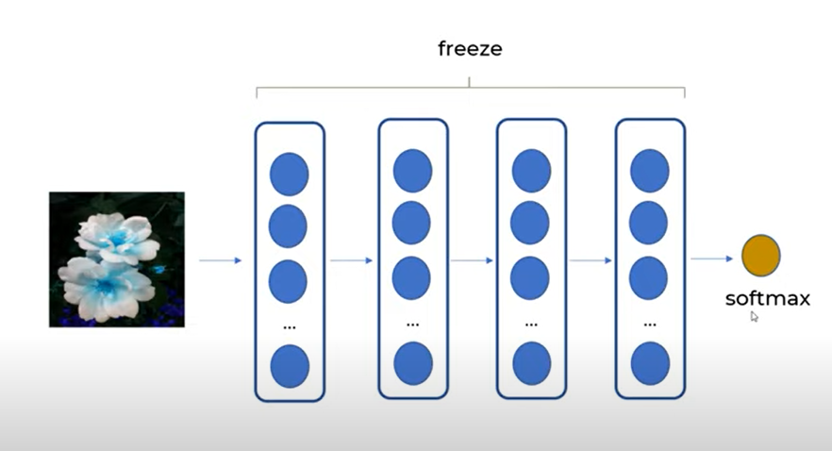
Transfer Learning

Slide 18
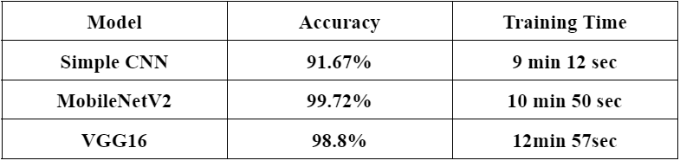
Result

Slide 19
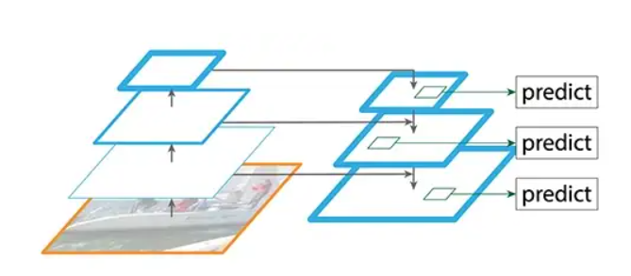
Localization : FPN
Feature Pyramid Network
Feature extractor
Bottom-up pathway as Normal CNN
Top down pathway :
High resolution features megre with low
Resolution features to give high quality
Feature maps.
https://jonathan-hui.medium.com/understanding-feature-pyramid-networks-for-object-detection-fpn-45b227b9106c

Slide 20
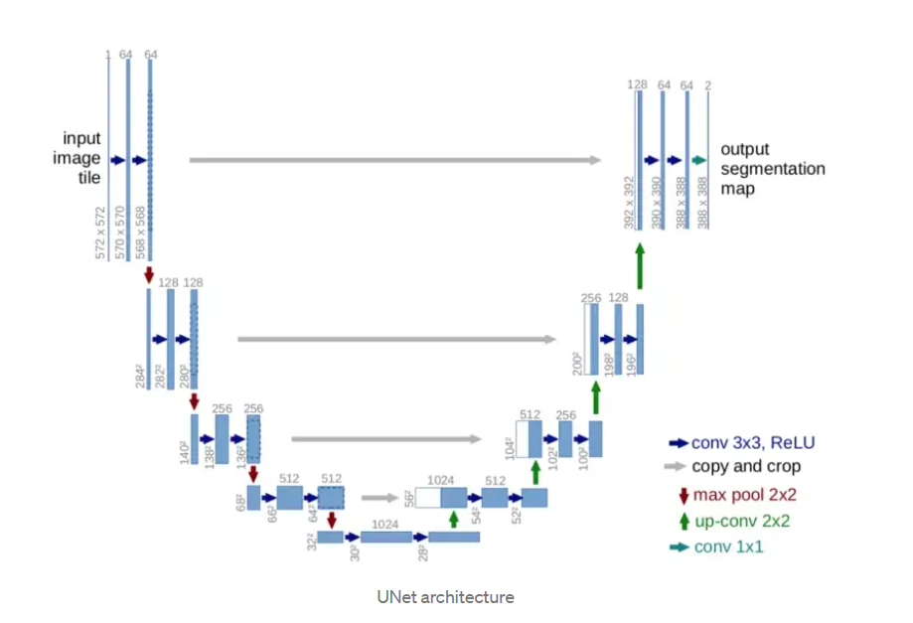
UNet
Invented in 2015 for Biomedical Images
Named because of it’s shape U.
It does classification on every pixel.
Input size == output size
Symmetric architecture and consist of 2 parts
Contracting path
(conv_layer1 -> conv_layer2 -> max_pooling -> dropout(optional))
Expansive path
(conv_2d_transpose -> concatenate -> conv_layer1 -> conv_layer2)
https://towardsdatascience.com/unet-line-by-line-explanation-9b191c76baf5

Slide 21
ResNet
Resnet solve vanishing Gradient problem.
When the network is too deep, the gradients from where the loss function is calculated easily shrink to zero after several applications of the chain rule. This result on the weights never updating its values and therefore, no learning is being performed.
Gradients can flow directly through the skip connections backwards from later layers to initial filters.
https://towardsdatascience.com/understanding-and-visualizing-resnets-442284831be8

Slide 22
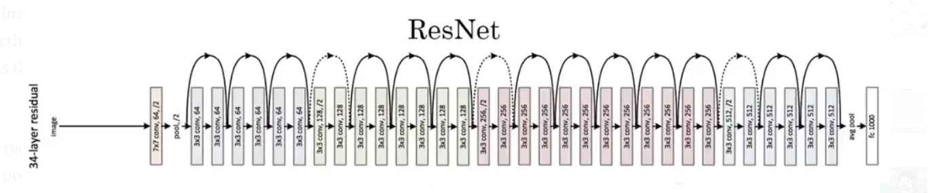

Slide 23
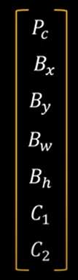
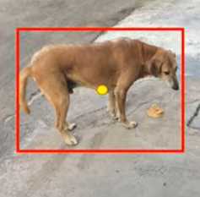
YOLO
YOLO stands for You Only Look Once.
We get an output in form of vector which stores various info such
as object centre’s coordinates as well as dimension of object.
What if we have multiple objects?
The answer is we use YOLO.
https://www.youtube.com/watch?v=ag3DLKsl2vk&t=455s&ab_channel=codebasics

Slide 24
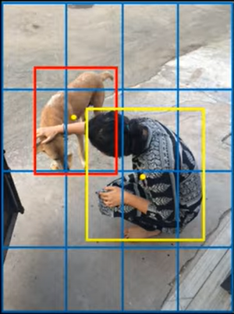
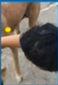
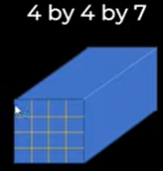
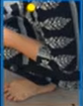
YOLO
In one forward pass we are making prediction.
We will now get 16 vectors of size 7 .

Slide 25
Result
Model | IOU | Epochs | Training Time
Unet with Resnet34 | 67.78 | 20 | 2hr 46 min
FPN with Resnet34 | 68.18 | 20 | 1hr 27 min
FPN with InceptionV4 | 66.33 | 20 | 4hr 16 min
YOLO | 68.4 | 20 | 19 min 40 sec
YOLO | 74.4 | 200 | 3hr 5 min

Slide 26
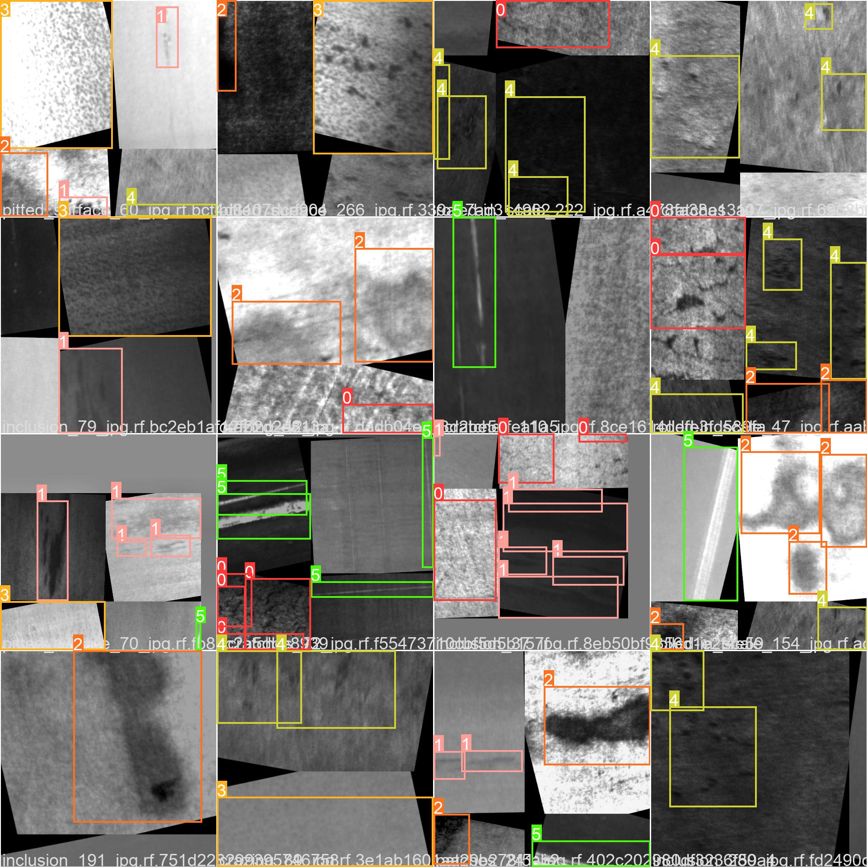
Result

Slide 27
Thank You
Submitted by -
Riddhima Pandey (B19ME064)
Satyam Kumar(B19ME076)

